Slide 1
Chapter 11
Entrepreneurship

Slide 2
Outline
How can you use information technology to improve your organization and make it better than your competitors?
How competitive is your world?
What are the main factors affecting a firm’s competitive advantage? Where do you begin looking for an edge?
How can you use IT to gain a competitive advantage? Where do you begin your search?
How can IT support the operations of the firm to provide a competitive advantage?
Why is it so difficult to convince management to make strategic changes? What are the risks of strategic decisions?
Why did so many dot-com firms fail? Do their failures mean there is no viable Internet strategy?
How do you start a business? How do you start an online business?
How will your business be different from the existing firms?
How do you turn an idea into money?
Is it true that genius is 1 percent inspiration and 99 percent perspiration?
What additional steps are required to start and EC firm?

Slide 3
Entrepreneurship and Small Business
Estimates | 2005 | 2009
Employer firms (non-farm) | 5,992,400 | 5,815,800
Employer firm births | 671,800 | 668,395*
Employer firm terminations | 544,800 | 592,410*
Self-employment, non-incorporated | 10,500,000 | 9,800,000
Self-employment, incorporated | 5,300,000 | 5,500,000
Business bankruptcies | 39,201 | 60,837
* Births and terminations are for 2007
A small firm has less than 500 employees.
Small firms in total employ 50.7 percent of all U.S. workers.
99.9 percent of the total U.S. firms are small.
http://www.sba.gov/advo/research/sb_econ2006.pdf
http://www.sba.gov/sites/default/files/sb_econ2010.pdf

Slide 4
Small Business Employees
http://www.census.gov/econ/susb/historical_data.html

Slide 5
Small Business Payrolls

Slide 6
Receipts and Payroll
Year | Receipts/Emp | Payroll/Emp
1997 | 64.4 % | 80.8 %
2002 | 63.0 % | 81.6 %
2007 | 62.9 % | 79.3 %
Computation:
Total receipts / total employees
Value for small firms / value for large firms
Small firms pay less per employee than large firms.
But their receipts per employee are even less.
So profitability is squeezed.

Slide 7
Turn-key Systems
Vendors create standard systems for common types of business
Dentist
Physician
Veterinarian
Attorney
Accountant
Restaurant
Hotel
Theater
Many, many more
Includes: hardware, software, training, and updates.

Slide 8

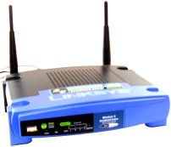



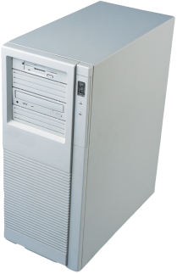
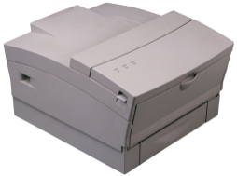
Information Technology Expertise
Service contracts for hardware.
Consultants for network and troubleshooting.
Assign someone to do backup.
Security is usually forgotten.
Upgrades and decision software are rare.
In 2001, Apple introduced a $500/year business support service.

Slide 9
Keeping up with Technology
past
future
Fixed cost/paid for. Know how to use. Mostly works.
Hardware failures. Limited features. Hard to repair.
New hardware features. New business methods. Improved security.
High prices for new technology. Uncertain life, adoption rates. Difficult to follow tech industry. Harder to find support. Constant switching and costs.

Slide 10
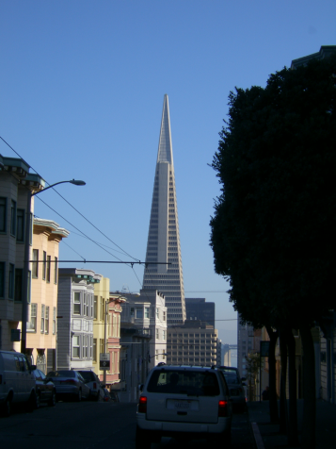

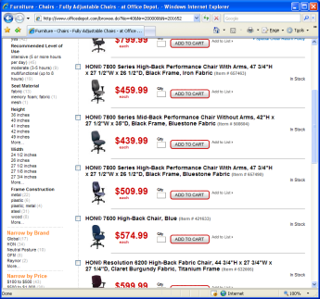
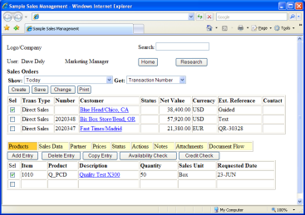
Strategic Power
Use supplier and customer ERP systems to track purchases and sales and reduce the need for your own system.
Big Supplier
Big Customer

Slide 11
Information Tasks
Operations | Accounting Sales Purchases Cash flow Production Shipping Payroll | Basic accounting software but it must use double-entry. Possibly online ERP service. Outsource payroll.
Tactics | Customer analyses Product analyses Employee evaluations Forecasting Growth Teamwork | Often skipped because of lack of expertise. Possible with spreadsheets and SharePoint.
Strategies | Smallest firm Minimal power Limited funds | Rely on larger customers and partners. Use online services.

Slide 12
Technology Levels
Level | Description | Cost Perspective
Build and manage technology yourself. | Often necessary for leading edge ideas or to customize to your management. | Expensive, difficult to control costs. Requires considerable IT expertise.
Buy commercial off-the-shelf hardware and software. | Relatively flexible today but still requires initial customization. | Mostly up-front costs and probably need consultants at the beginning.
Online service providers. | More options today. Easy to share data. Less worry about security and backups. | Minimal up-front costs. Flexible pricing and growth.
Buy low-end tools and patch together. | Many small businesses survive with Microsoft Office and an accounting package. | Can be low-cost, even go with open source software.

Slide 13

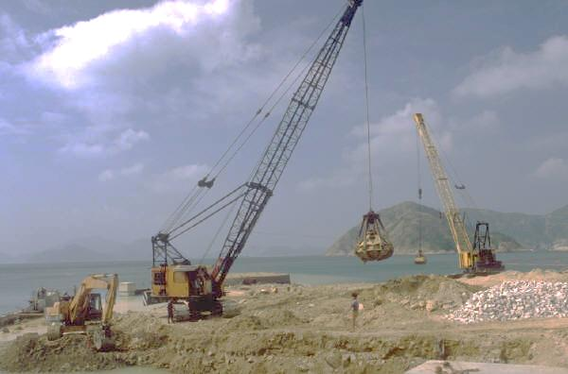
Creating a Business
Idea
Plan
Implementation

Slide 14
Production Chain
parts
supplier
parts
supplier
parts
supplier
warehouse
warehouse
supplier
supplier
supplier
tool
manufacturer
workers
Manufacturer
wholesaler
wholesaler
distributor
distributor
distributor
retail store
retail store
retail store
retail store
Consumers
Notes:
For radically new ideas, you might have to large portions of the production chain.
In other cases, you will want to find the point in the production chain where the greatest profit can be made.
Along the way, identify the main competitors at each stage.

Slide 15


Expand Your Focus
It might be better to sell your innovation as a service to the dominant firm or to be an intermediary for consumers.
Big competitor
You might try to compete directly.
customers

Slide 16
Industry Research
Competition
Number
Concentration ratios
Sales by firm
Technology plans
Size of the market
Number of customers
Amount of revenue
Growth rate
Market comparison for substitute products
Consumer focus group interviews
Production costs
Startup/fixed costs
Operating costs
Legal environment

Slide 17
IT Support for Research
Chapter 9: Many tools to analyze data.
Problem: Finding data. Some sources
Federal government
Census Bureau (Concentration ratio)
Bureau of Economic Analysis (Industry accounts)
Securities and Exchange Commission (EDGAR)
Financial reports
SEC and Individual
Summaries: WSJ/Dow Jones, Yahoo, Magazines
Commercial: D&B, S&P
Marketing specialist firms
Scanner data
Custom research
Online surveys
Focus groups
Searching Google searches

Slide 18
Check the Search Engines (Google)
Insights http://www.google.com/insights/search/#
Trends http://www.google.com/trends
Zeitgeist http://www.google.com/zeitgeist
Categories
Seasonality
Geography
Properties
build your own search
Adwords, keyword tool and traffic estimator (link)
Twitter: top tweets
The point: You can see what people (as a group) are searching for—at different points in time.
Adwords can help you estimate the potential number of customers.

Slide 19
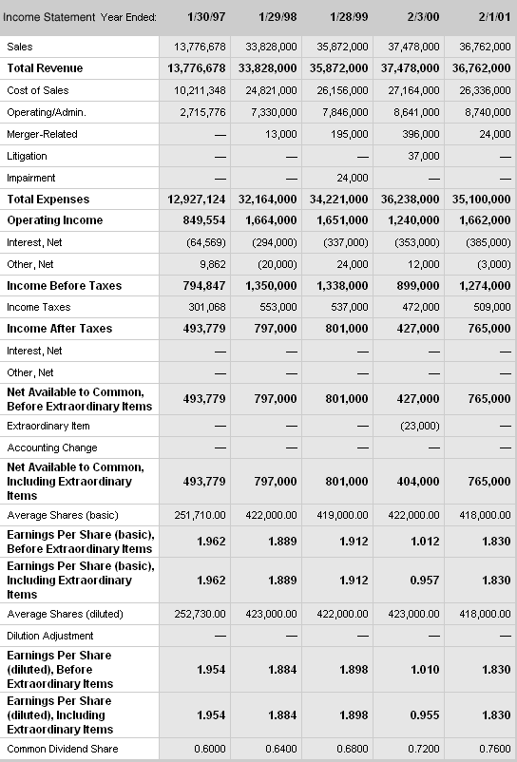
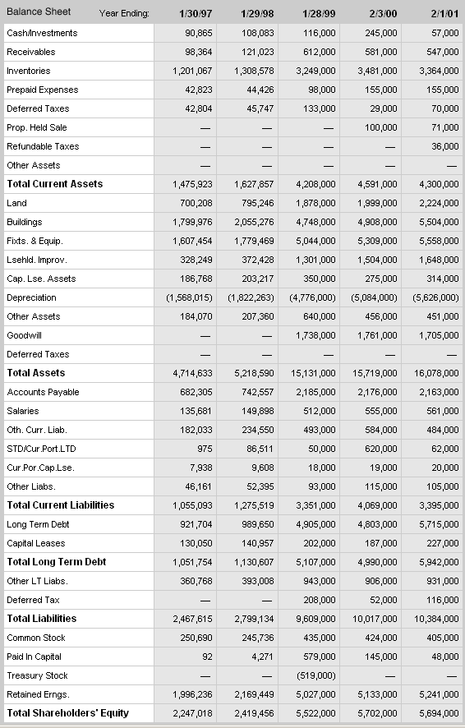
Business Plans
Executive Summary
Strategy, Competition, and Market Analysis
Forecasts, Cash Flow, and Investment Budget
Marketing
Organization and Timetable
tasks
time

Slide 20
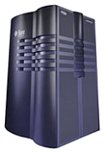

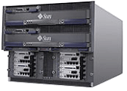

Forecasting Financial Data
Balance Sheet
Income Statement
Profit and Loss
Cash Flow
Customers and Sales estimate
Infrastructure scale
Employees
Financial statement estimates
Sales revenue
Marketing costs
Operating and selling costs
Salary costs
Financial statements and ratios

Slide 21
Breakeven Analysis
Revenue
Cost
Breakeven point

Slide 22
Forming a Corporation
State Forms
Articles of Incorporation
Corporate Bylaws
Registered Agent (self)
Business Registration Form
State Employer Number
Withholding ID
Sales Tax ID
Additional licenses
Federal Forms
SS-4 Application for Employer Identification Number
2553 Election by a Small Business Corporation
Commercial
Bank Account
DUNS Number
Accounting System
Purchase software
Hire accountant
Define chart of accounts
Standards
Additional detail
Define processes

Slide 23

Financing a Startup
Venture Capital
Angel Investor
Partners
Become owners with some control over management.
Successful firm IPO:
Additional funds
Reward to original investors
Funding for development and operations.

Slide 24
E-Business Setup: Pay Someone Else
Products
Use simple HTML, Amazon, eBay, or Web commerce server.
Process payments through PayPal, Google, or similar third party.
Hosted server is inexpensive today.
Build links to get picked up by search engines.
Services/Web 2.0+
Hosting: Use a hosted server or cloud computing.
Software Development
Do you have the skills to hire, organize, and evaluate programmers?
Will the code have to be updated and rewritten continually?
Can the software be built using existing modules?
Network effect.

Slide 25
E-Commerce Failures
Hundreds of dot-com firms failed in 2001 and 2002
Most relied on pure Internet revenue. Outsourcing production and shipping.
Most relied on advertising revenue—often revenue from other dot-com firms.
Many believed in the importance of being first to market and becoming the biggest, best-known firm in a niche industry.
Many believed that it was not necessary to make a profit on sales. Money from advertising and stock sales would be sufficient to keep the firm alive until the world changed.
Most were wrong.
Around mid-2000, several social networking sites were introduced and expanded for several years. The WSJ reported that Facebook made a profit in 2009. Other companies, such as Twitter continued searching for ways to make money. Most were living off investor money, some advertising revenue, and some deals with search engines.
Today, apply the same questions to newspaper sites. If they charge users, readership declines and ad revenue drops.

Slide 26
Dot-Com Advertising Crash
Outside advertising
$
Cross advertising
$
Outside advertising
Much of the cross advertising was not real money, simply agreements that were sometimes recorded as revenue.
When the outside money declined, and weak firms crashed; others crashed as well. Then they ran out of investor’s money.

Slide 27
Dot-Com 2.0?
Internet-based companies
Social network sites
Online services
Newspapers (similar as subscriptions decline)
Revenue sources?
Few fees on users
Depend on advertising
Some have huge numbers of users (costs)
Investor hype

Slide 28
Cloud Computing
Marginal cost pricing for processing, storage, and bandwidth.
Pay only for what you need
Minimal fixed costs
Minimal long-term commitments
Ultimately, at some scale, cloud marginal costs are higher than building your own.
But startup costs are low.
Scalability is built-in.
When you grow enough you can build your own.

Slide 29
Technology Toolbox: CAN-SPAM Act
All header information to be accurate.
Subject headings must be accurate.
(3) E-mail must contain an electronic opt-out mechanism. It must be functional for at least 30 days. You must also include a valid physical (postal) address.
(4) You must stop sending messages if a person opts out. You must stop sending messages within 10 business days.
(5) No e-mail address harvesting.
(6) Sexually explicit messages must be identified with “SEXUALLY-EXPLICIT” in the subject line.
(7) The Act applies to the sender and the advertiser. Even if you hire someone who sends the message, as the company or Web site being advertised, you can be held responsible for violations of the Act.
15 USC Chapter 103

Slide 30
Technology Toolbox: Business Plan/RT
Sales estimated while the firm was being formed.
RTBusinessPlan.xls

Slide 31
Rolling Thunder Bicycles Estimated Sales

Slide 32
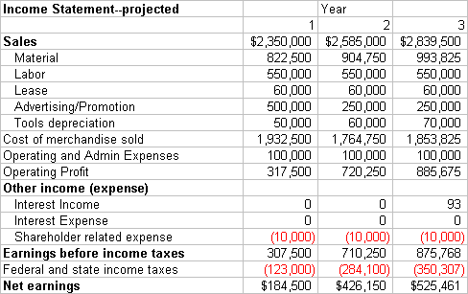
Projected Income Statement
Interest rate on borrow 8.00%
Interest rate on short term investments 3.00%
Depreciation, 5 years, straight line 0.2
Tools purchases $250,000 $50,000 $50,000

Slide 33
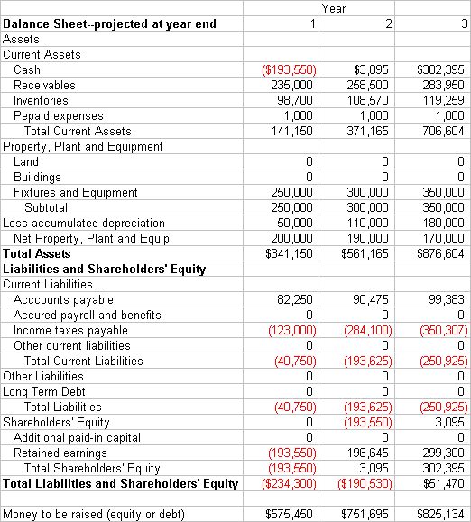
Projected Balance Sheet
Assumptions
Receivables as percent of sales: 10%
Payables as percent of material costs: 10%
Inventory as percent of material costs: 12%

Slide 34
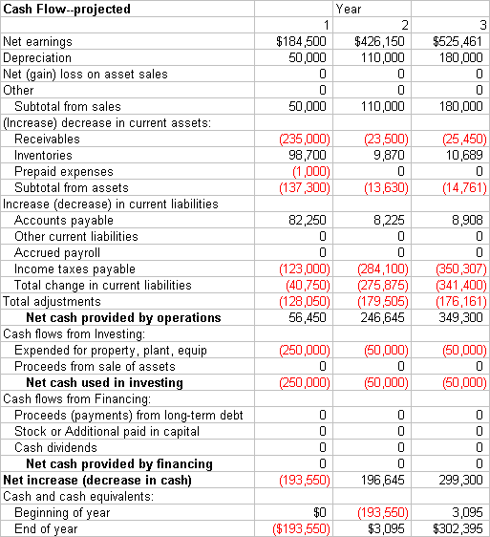
Projected Cash Flow

Slide 35
Quick Quiz: Business Plan
1. How can you forecast sales? What information would you want to collect?
2. How would the financial statements be different for an EC firm (for example, a website that sells photographs)?
3. What key element would you place in the marketing section for a service firm (e.g., dentist)?

Slide 36
Cases: Small Business

